Slide 1
Whittonstall & Broomley First Schools Federation
Maths Workshop

Slide 2
Maths Curriculum
Number and place value
Addition and subtraction
Multiplication and division
Fractions
Measurement
Geometry
Statistics
Notes:
New curriculum – more focus on speaking and listening. Learn poetry by heart. Spelling, punctuation and grammar. Old literacy strategies still available in archives for detail around genres.
New curriculum is less prescriptive – lots of scope for teachers to be creative. Allows the school to decide what they will cover and when. No set time that you should spend teaching English.

Slide 3
Why a mastery method?
The national curriculum for mathematics aims to ensure that all pupils:
become fluent in the fundamentals of mathematics, including through varied and frequent practice with increasingly complex problems over time, so that pupils develop conceptual understanding and the ability to recall and apply knowledge rapidly and accurately.
reason mathematically by following a line of enquiry, conjecturing relationships and generalisations, and developing an argument, justification or proof using mathematical language
can solve problems by applying their mathematics to a variety of routine and non-routine problems with increasing sophistication, including breaking down problems into a series of simpler steps and persevering in seeking solutions.
Mathematics is an interconnected subject in which pupils need to be able to move fluently between representations of mathematical ideas.

Slide 4
Why the Singapore Mastery method?
Mixed ability learning - too much differentiation and the LA will never fill the gap "it's easier to keep up than catch up".
Everything has a context - start with the problem.
Tackle areas of learning for longer without feeling the need to move on - tiny, step by step progression.
An equal entitlement to problem solving - not just fast finishers
Increased communication, listening to the views of others, multiple ways of seeing/doing things & use of different strategies - an expectation that you can think of another way.
Maths is creative!
Sometimes there is no correct answer

Slide 5
What is the Singapore method?
Concrete – Pictoral - Abstract
Reasoning
Problem solving

Slide 6
Let’s have a go!

Slide 7
Let’s have a go!

Slide 8
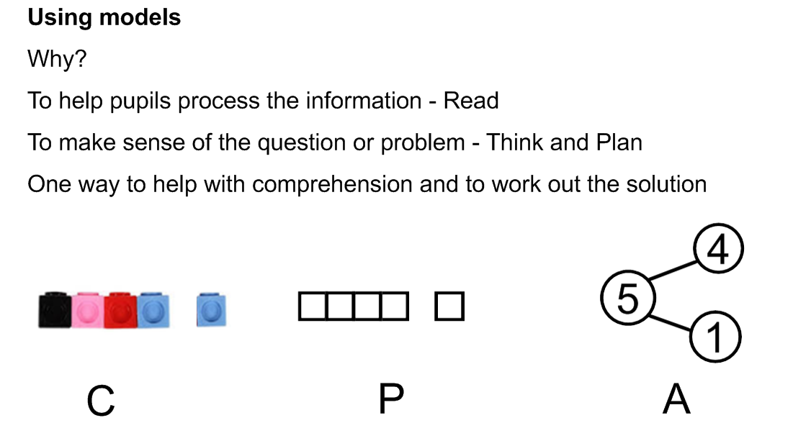
Using models

Slide 9
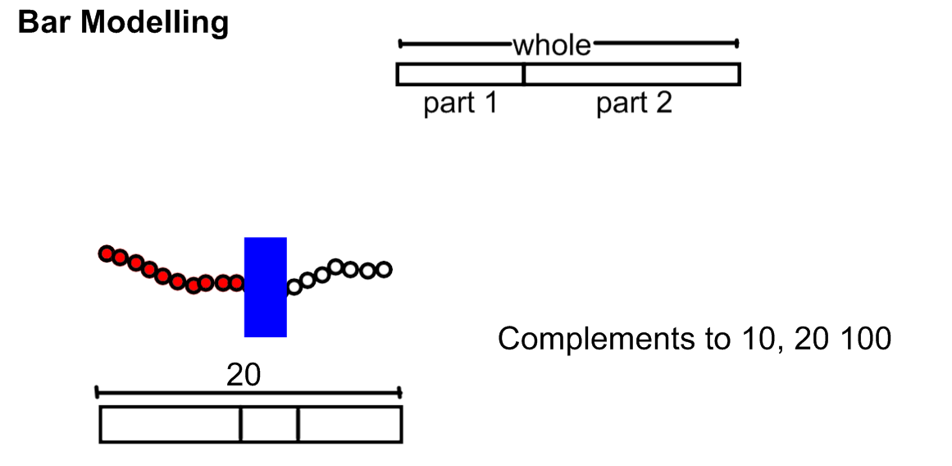
Using models

Slide 10
Progression through the Key Stages
Progression in calculations:
Addition
Subtraction
Multiplication
Division
Details of the latest calculation policy on the website for reference.

Slide 11
Mastery Maths- An inspire approach
Inspire Maths is a whole-school primary maths programme that supports teaching to mastery and meeting the higher expectations of the National Curriculum.
Based on Singapore's top maths series used in almost 100% of its state primary schools
A textbook programme which helps children to develop mastery, with essential assessment and curriculum support provided by Inspire Maths Online

Slide 12
How can you help?
An emphasis on vocabulary - try to encourage children to use it correctly and appropriately. E.g. digit/numbers.
Practice basic skills- number in the environment (speed signs), timers, countdowns.
‘Maths skills’ - Telling the time, times tables.
Homework- Mathletics for a whole school online maths approach.

Slide 13
Open Door
If your not sure please ask.
Details of this presentation and attached resources on the website.
Take copies of the resources on offer.
Thank you and remember…..

