Slide 1
Whittonstall & Broomley First Schools Federation
SpAG Workshop

Slide 2
English Curriculum
Spoken language (previously ‘speaking and listening’).
Reading (word reading and comprehension).
Writing (transcription (spelling and handwriting) and composition (articulating ideas and structuring them in speech and writing).
‘Pupils should be taught how to plan, revise and evaluate their writing.’
Spelling, vocabulary, grammar, punctuation and glossary.
Notes:
New curriculum – more focus on speaking and listening. Learn poetry by heart. Spelling, punctuation and grammar. Old literacy strategies still available in archives for detail around genres.
New curriculum is less prescriptive – lots of scope for teachers to be creative. Allows the school to decide what they will cover and when. No set time that you should spend teaching English.

Slide 3
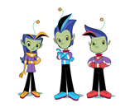
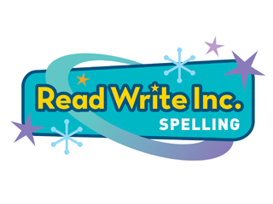
Spelling Programme: Read Write Inc Spelling

Slide 4
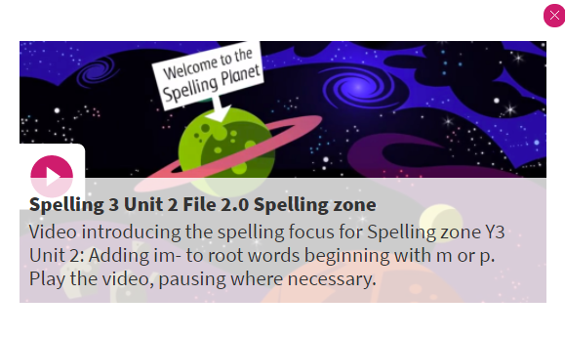
It uses characters from the ‘Spelling Zone’ to teach the spelling rules: there are lots of them!

Slide 5
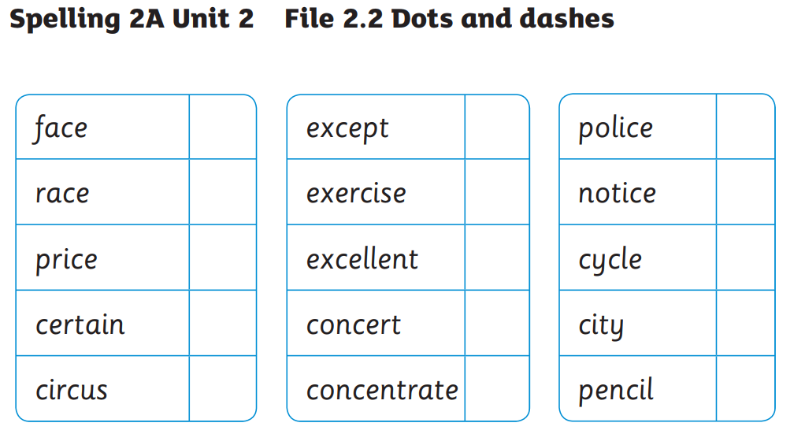

Slide 6
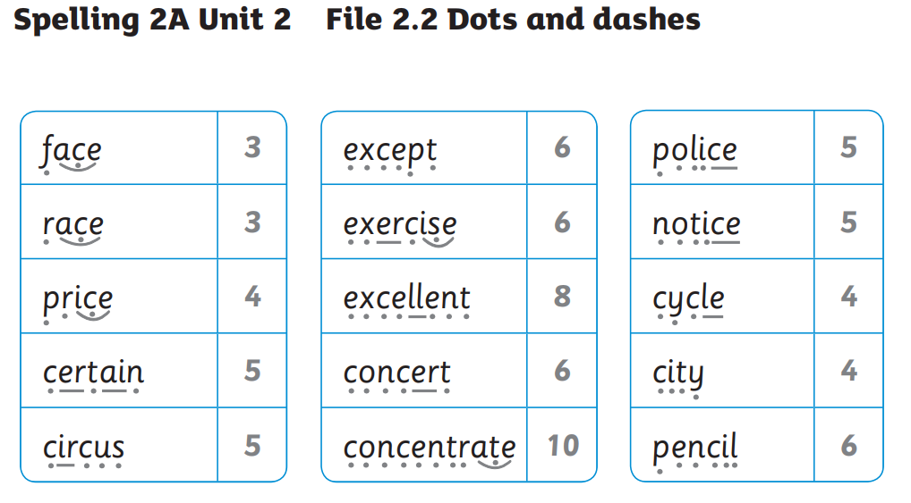

Slide 7
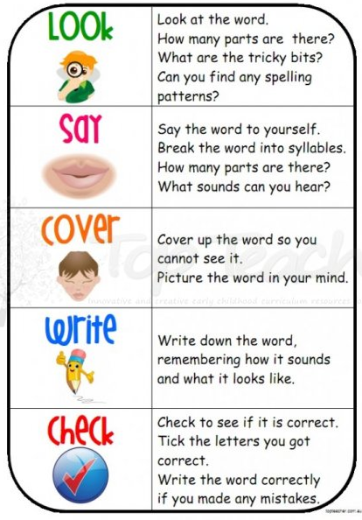
Strategies for learning spellings

Slide 8
Just remember… spelling is hard! https://www.youtube.com/watch?v=RwnBAHtc1D0

Slide 9
SPaG Spelling Punctuation and Grammar Vocabulary, grammar and punctuation terminology for pupils
Year 1
Year 2
Year 3
Year 4
Year 5
Year 6

Slide 10
Vocabulary, grammar and punctuation Year 1 terminology for pupils
Year 1 | capital letter | exclamation mark | full-stop
 | letter | plural | punctuation
 | question mark | sentence, 2 | singular
 | word

Slide 11
Vocabulary, grammar and punctuation Year 2 terminology for pupils
Year 1 terminology plus:
Year 2 | adverb | adjective | apostrophe
 | comma | command | compound
 | exclamation | noun | noun phrase
 | question | statement | suffix
 | tense [past, present] | verb

Slide 12
Vocabulary, grammar and punctuation Year 3 terminology for pupils
Year 1 & 2 terminology plus:
Year 3 | a/an | clause | conjunction, 2
 | consonant | consonant letter | direct speech
 | inverted commas | prefix, 2 | preposition, 2
 | speech marks | subordinate clause | vowel
 | vowel letter | word family

Slide 13
Vocabulary, grammar and punctuation Year 4 terminology for pupils
Year 1, 2 & 3 terminology plus:
Year 4 | adverbial | determiner
 | possessive pronoun | pronoun

Slide 14
a/an
If a word begins with a consonant, we write
a bird
a school
a tall mountain.
If a word begins with a vowel, we write
an apple
an amazing time
an owl.
Y3

Slide 15
adjective
Adjectives are describing words.
tall, angry, green, old, smooth
These adjectives are used to describe an noun.
Adjectives are placed before the noun.
a tall alien,
a green alien
an angry alien.
We can use them together, with commas.
a tall, green and angry alien.
Y2

Slide 16
adverb
An adverb is a word in a sentence that says how or in what way something is happening.
Many adverbs end in –ly but not all.
Adverbs of manner:
She listened carefully.
[oddly, safely, quietly, loudly, slowly, smoothly]
Adverbs of time
We had the work completed earlier.
[weekly, daily, yearly, hourly, later, finally]
Y2

Slide 17
adverbial
An adverbial is an adverb, phrase or clause used to add information to a verb.
An adverbial tells you where, when, how often, how long or how much something happens.
I’ll meet you by the swings.
We caught the bus yesterday.
I drive past the school carefully every day.
It will me take all morning to clean the car.
An adverbial can be a ‘fronted adverbial:
Later that day, I felt better.
Y4

Slide 18
apostrophe (’)
Apostrophes look similar to commas BUT are written above letters, not on the line.
Apostrophes are used to show possession [before an ‘s’].
Amy’s pencil
cat’s milk bowl
Apostrophes are used to replace letters [contractions].
can’t, don’t, shan’t,
mustn’t, I’m, we’ve
P
Y2

Slide 19
capital letter
A capital letter always begins a sentence.
Today is my birthday and I am 8 years old.
Capital letters are used for days of the week and months of the year.
Monday, Tuesday, Wednesday, …
January, February, March, …
Capital letters are used for all names.
London, Clara, Waterloo, Tesco, Wales
‘I’ is always a capital letter.
P
Y1

Slide 20
clause
A clause is a group of words in a sentence.
It can be used as a whole sentence.
All clauses have a verb.
A sentence is made up of one or more clauses.
The green bird pecked an apple.
Ella has five pets because she likes animals.
Y3

Slide 21
comma (,)
A comma looks like a full stop with a tail.
Commas are used to separate things in a list.
In my basket, I had cheese, milk and bread.
A comma is also used after ‘setting the scene’ in a sentence, or after a fronted adverbial.
As soon as I have finished, we can go into town.
A comma is used after these words and phrases:
However, Consequently, Therefore,
Of course, As a result,
P
Y2

Slide 22
compound
A compound word has at least 2 root words.
The two root words are written ‘joined together’ as a compound word.
A compound word usually has a different meaning than the two separate words.
blackbird, bookshop, snowman, buttercup,
Sometimes a hyphen [-] is used in between the two words.
ice-cream, baby-sit, one-eyed, blow-dry
Y2

Slide 23
conjunction
Conjunctions are ‘connecting words’, used to join words or groups of words together. [A junction is where two things join].
and but or then so if after
when before after while because
You can also start a sentence with a conjunction.
Ella has five pets because she likes animals.
When it stops raining, I’m going out.
Y3

Slide 24
determiner
A determiner specifies a noun as known or unknown.
A determiner is either general, specific or a quantifier.
General determiners: a, an, any, another. other, what
Specific determiners: the, my, your, his, her, its, our, their, whose, this, that, these, those, which.
Quantifying determiners: all, any, enough, less, a lot of, lots of, more, most, none of, some, both, each, every, a few, fewer, neither, either, several.
A determiner can be an article: a, an, the
A determiner can be possessive: my, your, his, her, our, their
Y4

Slide 25
exclamation
Exclamations are simple sentences.
Exclamations begin with a capital letter.
Exclamations usually end in an exclamation mark.
Exclamations are full of emotion!
Exclamations can be joyful, wonderful, angry or surprizing.
That was amazing! I’m so happy!
I’ll catch you! Oh dear!
Haven’t you grown! Ouch!
Look out! Mind the step! Wow!
What a beautiful day! Stop!
Y2

Slide 26
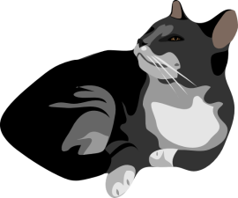
noun phrase
A noun phrase is a phrase with a noun at its head.
Examples of noun phrases are in blue as each one tells us more about the cat.
My cat is asleep.
My black cat is asleep.
My lazy, black cat is asleep.
On the sofa, my lazy, black cat is asleep.
Y2

Slide 27
prefix
A prefix is added at the beginning of a ‘root’ word in order to turn it into another word.
un + happy = unhappy
dis + appear = disappear
mis + behave = misbehave
re + do = redo
im + possible = impossible
anti + clockwise = anti clockwise
Y3

Slide 28
preposition
Preposition means positioned before [a noun].
Therefore prepositions link the following noun, pronoun or noun phrase to some other word in the sentence.
Prepositions describe where [e.g. under, over, between] or when [after, before, during] something happened.
We got home at midnight. Are you coming with me? They jumped over a fence.
Y3

Slide 29
pronoun
A pronoun is word that replaces a noun.
A pronoun can be personal: I, me, you, he, him, she, her, we, us, they, them, it.
A pronoun can be possessive: his, hers, mine, ours, yours, theirs, its
A pronoun can be indefinite: someone, nobody, anything, everything.
Emily watched the film and she loved it.
Y4

Slide 30
punctuation
Punctuation marks are used in sentences to make the meaning clearer.
full-stop | . | semi-colon | ;
capital letters | ABC | dash | -
question marks | ? | brackets | ( )
exclamation marks | ! | ellipsis | …
comma | , | hyphen | -
apostrophe | ’ | bullet points
speech marks | “ ” | finger space
colon | :
Y1

Slide 31
semi-colon (;)
A semi-colon is a punctuation mark, made up of a dot above a comma.
A semi-colon can be used to show a break in sentence.
If used as a break, a semi-colon gives a ‘longer’ break than a comma.
The girl had never been so terrified; she backed away but there was nowhere to hide.
The film was great; I had a great time.
P
Y6

Slide 32
sentence
A sentence is a group of words with a verb.
All sentences must make sense.
All sentences begin with capital letter.
A sentence can be a statement, a question, a command or an exclamation.
A sentence ends with a full-stop, a question mark or an exclamation mark.
It is very sunny today.
When are you coming to tea?
Shut that door!
Y1

Slide 33
sentence
Sentences can be simple [one clause].
There is a dog next door.
Sentences can be compound [2 clauses linked together with a conjunction].
The ginger cat was sitting on the wall and it jumped onto a rat.
Sentences can be complex [a main clause, a conjunction, and a subordinate clause].
The postman, who was coming down the path, delivered my birthday present.
Y1

Slide 34
singular/plural
Singular means only one.
Plural means more then one.
singular plural
a cat two cats
one year 6 years
the bus those buses
a box ten boxes
my baby my babies
our family their families
Y1

Slide 35
statement
Statements are simple sentences.
Statements begin with a capital letter.
Statements end with a full stop.
The cat was sitting on the wall.
My tummy is rumbling.
It is nearly bedtime.
Goldilocks knocked on the yellow door.
Y2

Slide 36
subject
The subject of a verb is normally the noun, noun phrase, or the pronoun that names the do-er or be-er.
The subject’s normal position is just before the verb in a statement.
The dog escaped from the garden.
The subject can be in the first person [I, we], second person [you] or third person [he, she, it, they].
Y6

Slide 37
subordinate clause
A subordinate clause (or dependent clause) does not make sense on its own.
A subordinate clause begins with a subordinating conjunction, e.g. when, if, although, because until.
I fished until the sun went down.
Although it had stopped raining, Anne still
wore her raincoat to walk home.
Y3

Slide 38
suffix
A suffix is added at the end of a ‘root’ or ‘base’ word in order to turn it into another word.
book + s = books
walk + ed = walked
wash + ing = washing
soft + er = softer
length + en = lengthen
enjoy + ment = enjoyment
good + ness = goodness
joy + ful = joyful
quiet + ly = quietly
Y2

