Slide 1
Broomley First School
Phonics Workshop
Monday 18th September

Slide 2
Aims of the session:
Key terminology
Overview of how phonics is delivered in school
Opportunity to try phonics activities
Learning at home

Slide 3
In school, we follow the Letters and Sounds programme. Letters and Sounds is a phonics resource published by the Department for Education and Skills which consists of six phases. We also use Jolly Phonics actions and songs.
Phonics sessions are delivered daily, in small groups, through multi-sensory activities.

Slide 4
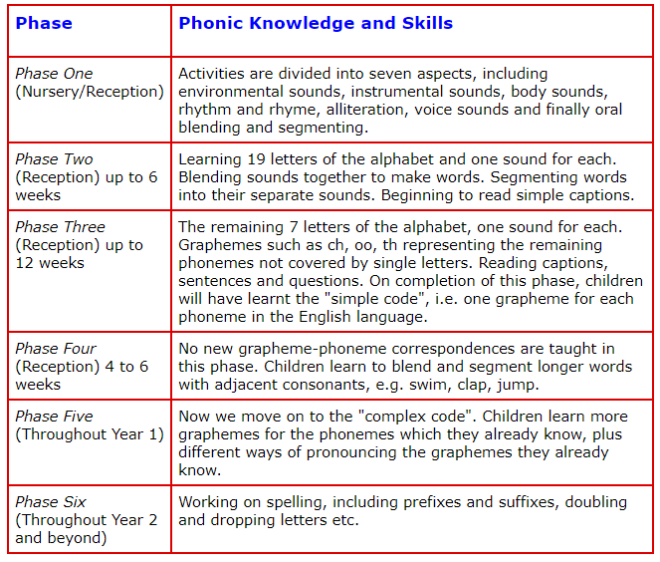
Phases of Phonics

Slide 5
Phonic terminology: some definitions
Notes:
Correct terminology should be introduced from YR onwards.
Children do not have a problem using phonic terminology (in fact they are often very proud of their ability to do so).
However, you are likely to meet resistance from some teachers who consider it ‘over the top’ and unnecessary to teach this vocabulary to children. It is sometimes worth using a numeracy analogy with these staff: we wouldn’t dream of teaching 3-D shapes to children and using the word ‘ball’ instead of ‘sphere’ or ‘box’ instead of cube/cuboid.
The principle with phonic vocabulary is exactly the same – it’s just that we haven’t been used to using these words with children until relatively recently.
Using phonic terminology from the outset ensures accuracy and promotes shared understanding between practitioners and practitioners and children.

Slide 6
Phoneme
Graphemes
Segmenting and blending
Digraph
Trigraph
Split digraph

Slide 7
Phoneme
A phoneme is the smallest unit of
sound in a word.
C-u-p c-a-t d-o-g

Slide 8
Grapheme
Letter(s) representing a phoneme
t ai igh

Slide 9
Blending
Recognising the letter sounds
in a written word, for example
c-u-p, and merging or synthesising
them in the order in which they
are written to pronounce the
word ‘cup’.

Slide 10
Oral blending
Hearing a series of spoken sounds and merging them together to make a spoken word – no text is used.
For example, when a teacher calls out
‘b-u-s’, the children say ‘bus’.
This skill is usually taught before blending and reading printed words.

Slide 11
Segmenting
Identifying the individual sounds in a spoken word
(e.g. h-i-m) and writing down or manipulating letters for each sound to form the word ‘him’.

Slide 12
Digraph
Two letters, which make one sound
A consonant digraph contains two consonants
sh ck th ll
A vowel digraph contains at least one vowel
ai ee ar oy

Slide 13
Trigraph
Three letters, which make one sound
igh dge

Slide 14
Split digraph
A digraph in which the two letters are not adjacent (e.g. make).

Slide 15
C consonant phoneme
V vowel phoneme
C consonant phoneme

Slide 16
High frequency words
The majority of high frequency words are phonically regular.
Some exceptions – for example the and was – should be directly taught.

Slide 17
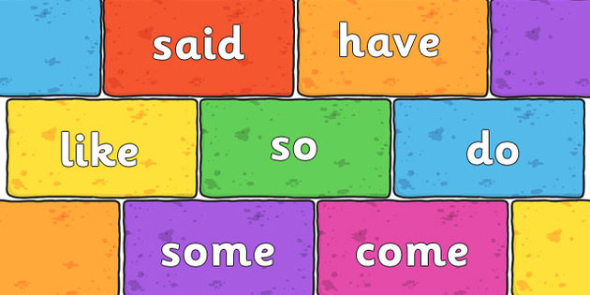
Tricky Words – differentiated for each Phase
• Not decodable, are learnt from sight.

Slide 18
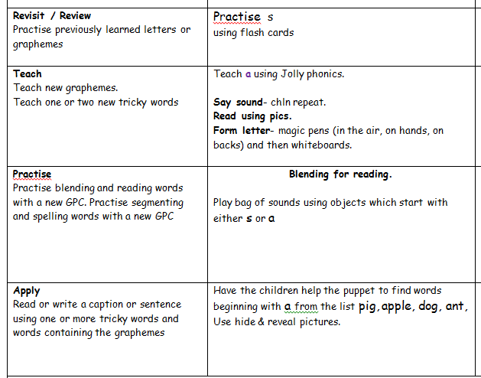
What Phonics looks like…

Slide 19
Activities.

Slide 20
Learning at home.

Slide 21
How should I pronounce the sounds?
http://mrthorne.com/home/phonics/letters-and-sounds/
It is important to pronounce sounds in a pure way…
Try m-a-t

Slide 22
What can I do at home?
Nursery rhymes
Enjoy and share books together
Model good reading habits
Read with your child – ask your child to attempt unknown words, using their phonic skills and knowledge.
Talk about the meaning of the book, too – take time to talk about what is happening in the book, or things that they found really interesting in an information book. Discuss the characters and important events. Ask them their views.
Provide toys, puppets and dressing-up clothes that will help them to act out stories.

Slide 23
Reluctant Writers/Readers
Model writing
Compose an email together, inviting a friend over to tea.
Magnetic letters
Leave a message on the fridge door and encourage them to write a reply to you.
Make up stories (shared writing)
Recipes

Slide 24
Love of Reading
Make sure your child sees you reading. Read to your child. Show enthusiasm!
Bring stories to life by using loud/soft/scary voices – let yourself go!
Spread books around your house for your child to dip into.
Let your child choose what they would like to read – books, comics, catalogues.
Read favourite books over and over again. Enjoy!

Slide 25
Useful Websites:
Mr Thorne does Phonics http://mrthorne.com/
Teach Your Monster to Read http://www.teachyourmonstertoread.com/
Phonics Play http://www.phonicsplay.co.uk/
iPad- Twinkl Phonics app/ Alphablocks app

Slide 26
Year One Phonics Screening
Tests children’s knowledge of Grapheme, Phoneme Correspondence
Words which contain all 44 phonemes, including the alternative spellings
Mix of real and alien words (flashcards) (phase 3-5)
Pass mark in June 2016 was 32/40
Take test again in Year 2 if children do not pass in Y1

Slide 27
Thank you for coming.

